Slide 1

158.225 Assignment 2 – art space
John Lamb
Marc Van Zuilen
Simon Parr

Slide 2

Art space – A presentation
In this talk:
Understand Requirements
Class Diagram
Use Case Diagram
Activity Diagram
Business Processes
Questions

Slide 3
REQUIREMENTS CONCEPT MAP
Notes:
Activity Diagrams:
Activity diagrams are used to represent the activities, actions, or processes themselves. They represent workflow throughout a process. They use a specific syntax, a symbology. Round tangles are used to denote Actions or Activities whereas standard rectangles are used to for classes. Solid arrows to indicate flow control, dotted for object control. Diamonds details decisions or mergers, and their outcomes are described.
Business Process Model Notation:
Business Process Model Notation, or BPMN, is a standardised graphic method of modelling processes that occur within organisations. The use of a specific, standardised notation is advantageous as it allows modellers to communicate procedures more effectively, share them precisely, and thereby achieve greater understanding of requirements.
BPMN is typically used to model business, or organisation, activities. It is these activities that when combined in to processes, support the way businesses or organisations function. An example of this could be the creation of a new product to sell, or even the process of selling. Any activity an organisation undertakes can be modelled.
From an object oriented standpoint, it is possible to divide various activities between objects (such as people interacting during a sales process).
Modelling takes time, evening using standardised notation. It is an abstract process that involves an interpretation of what reality should be. As such, it is important to remember that it is impossible to conceptualise the entirety of an unknown process initially; an agile, collaborative, and flexible approach must be adopted, allowing changes to be incorporated to better reflect real-world requirements.
Despite best efforts, however, modelling and usage of BPMN is not without its hazards. A common mistake is to reduce interdependent entities to divisive, segregated roles.

Slide 4
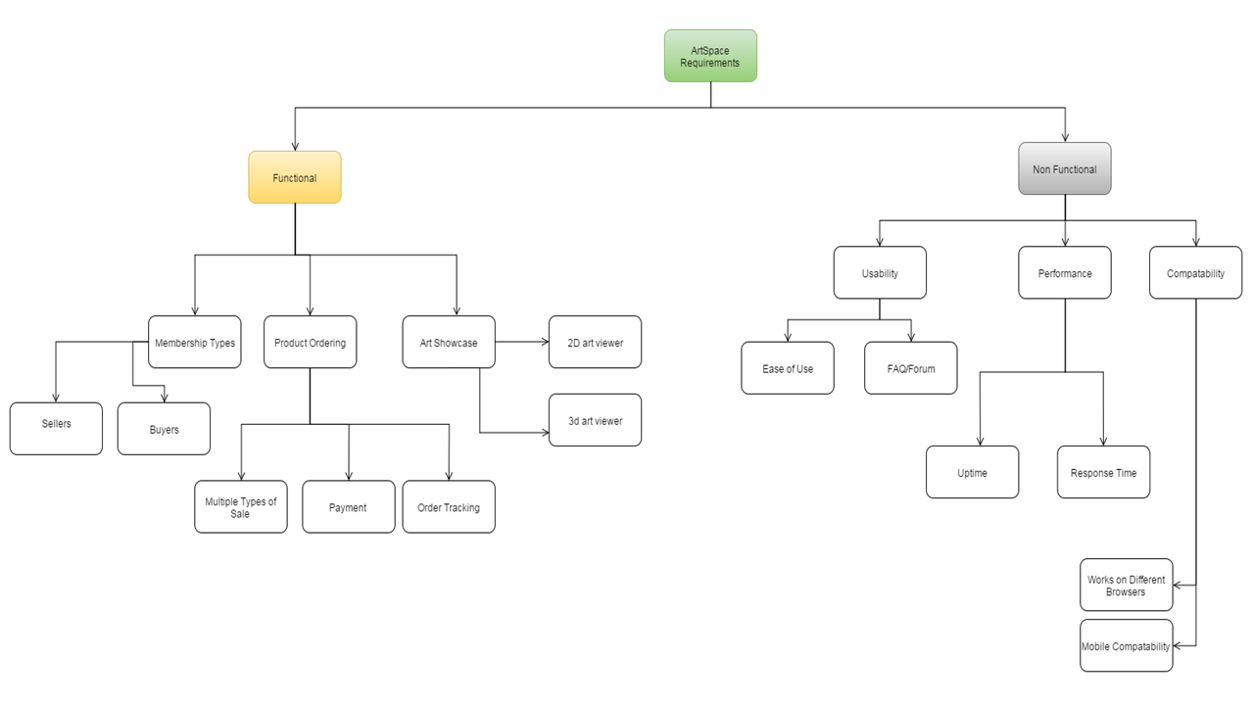
REQUIREMENTS CONCEPT MAP

Slide 5
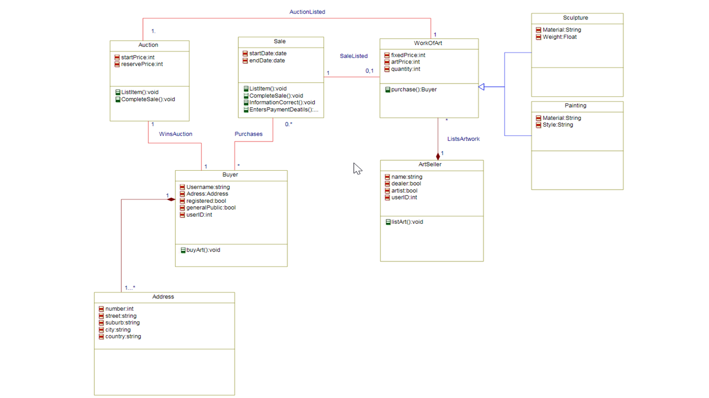
CLASS DIAGRAM

Slide 6
Use Case Diagrams
A use case diagram provides a simple demonstration of the main functions of the system and the users that interact with it.
Very popular and effective form of system analysis
A great way to summarise the goals of the system and overall scope of the planned system.
Does not got into any detail about each use case therefore it analyses the system at a very high level
Small version of use case diagram here
Notes:
Activity Diagrams:
Activity diagrams are used to represent the activities, actions, or processes themselves. They represent workflow throughout a process. They use a specific syntax, a symbology. Round tangles are used to denote Actions or Activities whereas standard rectangles are used to for classes. Solid arrows to indicate flow control, dotted for object control. Diamonds details decisions or mergers, and their outcomes are described.
Business Process Model Notation:
Business Process Model Notation, or BPMN, is a standardised graphic method of modelling processes that occur within organisations. The use of a specific, standardised notation is advantageous as it allows modellers to communicate procedures more effectively, share them precisely, and thereby achieve greater understanding of requirements.
BPMN is typically used to model business, or organisation, activities. It is these activities that when combined in to processes, support the way businesses or organisations function. An example of this could be the creation of a new product to sell, or even the process of selling. Any activity an organisation undertakes can be modelled.
From an object oriented standpoint, it is possible to divide various activities between objects (such as people interacting during a sales process).
Modelling takes time, evening using standardised notation. It is an abstract process that involves an interpretation of what reality should be. As such, it is important to remember that it is impossible to conceptualise the entirety of an unknown process initially; an agile, collaborative, and flexible approach must be adopted, allowing changes to be incorporated to better reflect real-world requirements.
Despite best efforts, however, modelling and usage of BPMN is not without its hazards. A common mistake is to reduce interdependent entities to divisive, segregated roles.

Slide 7
Pros/Cons of Use Case Diagrams
The primary advantage of using a use case diagram is that they include very little technical information therefore they are simpler for anyone including management to understand. They allow users to visualise the interactions between the actors (users) and the actions (use cases) of the system.
Focuses on users rather than the system so the real needs for the system to be a success are realised early
As they are typically drawn during the gathering of requirements they can prove useful in discovering additional high level requirements of the system in particular functional requirements.
While they are useful for displaying functional requirements they are not particularly useful in displaying non functional requirements of the system.
Notes:
Activity Diagrams:
Activity diagrams are used to represent the activities, actions, or processes themselves. They represent workflow throughout a process. They use a specific syntax, a symbology. Round tangles are used to denote Actions or Activities whereas standard rectangles are used to for classes. Solid arrows to indicate flow control, dotted for object control. Diamonds details decisions or mergers, and their outcomes are described.
Business Process Model Notation:
Business Process Model Notation, or BPMN, is a standardised graphic method of modelling processes that occur within organisations. The use of a specific, standardised notation is advantageous as it allows modellers to communicate procedures more effectively, share them precisely, and thereby achieve greater understanding of requirements.
BPMN is typically used to model business, or organisation, activities. It is these activities that when combined in to processes, support the way businesses or organisations function. An example of this could be the creation of a new product to sell, or even the process of selling. Any activity an organisation undertakes can be modelled.
From an object oriented standpoint, it is possible to divide various activities between objects (such as people interacting during a sales process).
Modelling takes time, evening using standardised notation. It is an abstract process that involves an interpretation of what reality should be. As such, it is important to remember that it is impossible to conceptualise the entirety of an unknown process initially; an agile, collaborative, and flexible approach must be adopted, allowing changes to be incorporated to better reflect real-world requirements.
Despite best efforts, however, modelling and usage of BPMN is not without its hazards. A common mistake is to reduce interdependent entities to divisive, segregated roles.

Slide 8
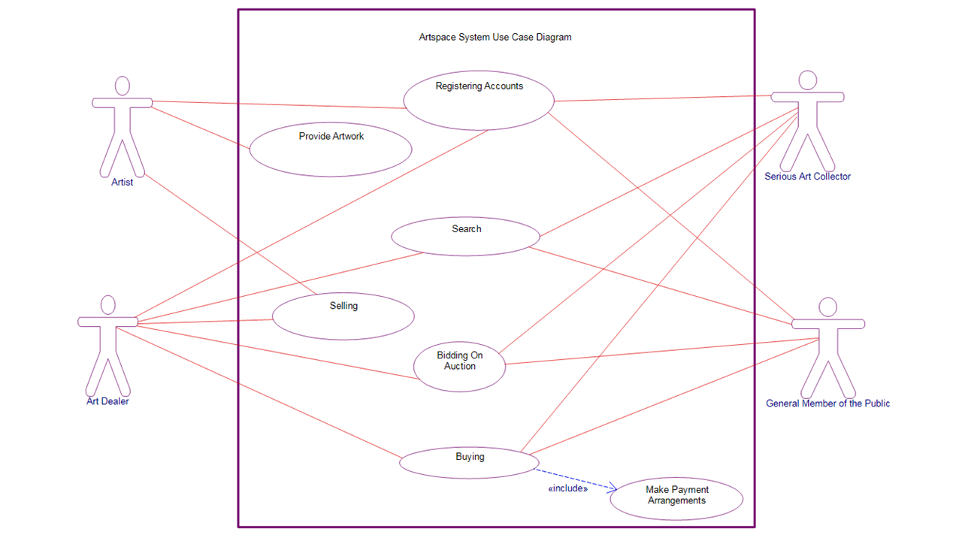
USE CASE DIAGRAM

Slide 9
activity diagrams and bpmn
What is an Activity Diagram?
An illustration of Work Flow
Shows activities and flows
Has a syntax
What is Business Process Modelling and Notation (BPMN)?
A standardised method of modelling processes
Breaks activities and flows in to entities
Has a Syntax
Notes:
Activity Diagrams:
Activity diagrams are used to represent the activities, actions, or processes themselves. They represent workflow throughout a process. They use a specific syntax, a symbology. Round tangles are used to denote Actions or Activities whereas standard rectangles are used to for classes. Solid arrows to indicate flow control, dotted for object control. Diamonds details decisions or mergers, and their outcomes are described.
Business Process Model Notation:
Business Process Model Notation, or BPMN, is a standardised graphic method of modelling processes that occur within organisations. The use of a specific, standardised notation is advantageous as it allows modellers to communicate procedures more effectively, share them precisely, and thereby achieve greater understanding of requirements.
BPMN is typically used to model business, or organisation, activities. It is these activities that when combined in to processes, support the way businesses or organisations function. An example of this could be the creation of a new product to sell, or even the process of selling. Any activity an organisation undertakes can be modelled.
From an object oriented standpoint, it is possible to divide various activities between objects (such as people interacting during a sales process).
Modelling takes time, evening using standardised notation. It is an abstract process that involves an interpretation of what reality should be. As such, it is important to remember that it is impossible to conceptualise the entirety of an unknown process initially; an agile, collaborative, and flexible approach must be adopted, allowing changes to be incorporated to better reflect real-world requirements.
Despite best efforts, however, modelling and usage of BPMN is not without its hazards. A common mistake is to reduce interdependent entities to divisive, segregated roles.

Slide 10
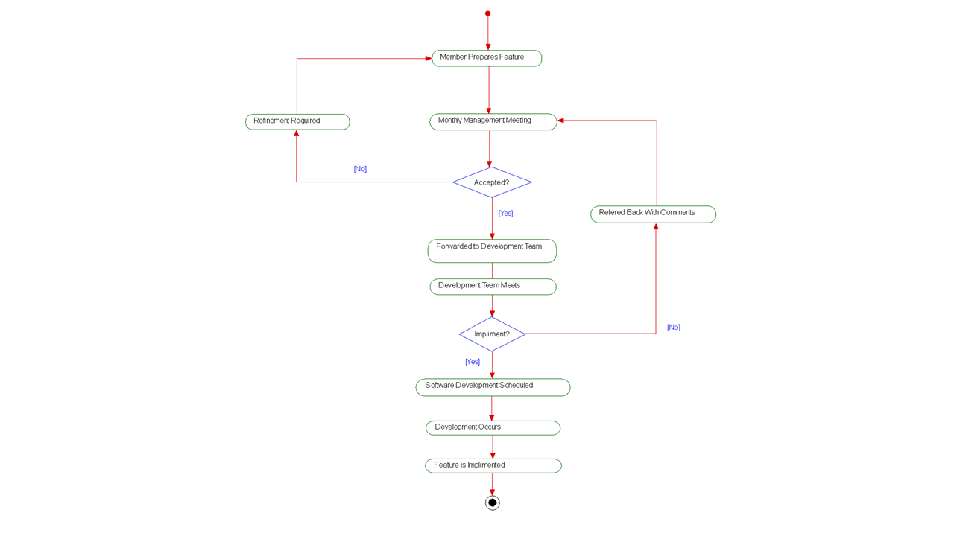
ACTIVITY DIAGRAM – ADDING A NEW FEATURE

Slide 11
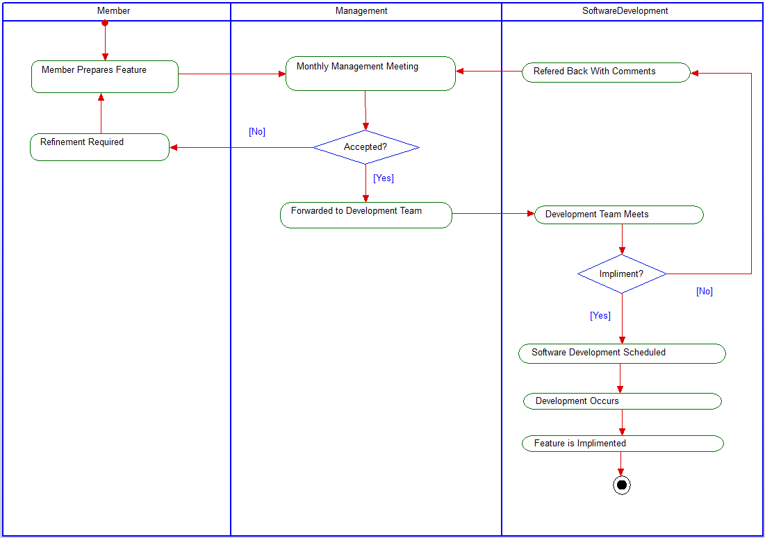
BPMN – ADDING A NEW FEATURE

Slide 12
Questions?
Marc van Zuilen - Requirements Map and Class Diagram
John Lamb – Use Case Diagram
Simon Parr - Activity Diagram and BPMN
Notes:
Activity Diagrams:
Activity diagrams are used to represent the activities, actions, or processes themselves. They represent workflow throughout a process. They use a specific syntax, a symbology. Round tangles are used to denote Actions or Activities whereas standard rectangles are used to for classes. Solid arrows to indicate flow control, dotted for object control. Diamonds details decisions or mergers, and their outcomes are described.
Business Process Model Notation:
Business Process Model Notation, or BPMN, is a standardised graphic method of modelling processes that occur within organisations. The use of a specific, standardised notation is advantageous as it allows modellers to communicate procedures more effectively, share them precisely, and thereby achieve greater understanding of requirements.
BPMN is typically used to model business, or organisation, activities. It is these activities that when combined in to processes, support the way businesses or organisations function. An example of this could be the creation of a new product to sell, or even the process of selling. Any activity an organisation undertakes can be modelled.
From an object oriented standpoint, it is possible to divide various activities between objects (such as people interacting during a sales process).
Modelling takes time, evening using standardised notation. It is an abstract process that involves an interpretation of what reality should be. As such, it is important to remember that it is impossible to conceptualise the entirety of an unknown process initially; an agile, collaborative, and flexible approach must be adopted, allowing changes to be incorporated to better reflect real-world requirements.
Despite best efforts, however, modelling and usage of BPMN is not without its hazards. A common mistake is to reduce interdependent entities to divisive, segregated roles.

